Slide 1
Parking Data
Liz
By: Kailey Carbone, Peter Xiong, Jessica Pilon & Elizabeth Hibbard
Notes:
Introduce Project.

Slide 2
What questions were we trying to answer?
What is the mean, median, mode of the parking capacity in the top 10 largest cities?
What are the outliers within the data?
What parking type is the most common?
How do the parking types very per city?
How common are the parking types?
How do the parking types vary across all 10 of the cities?

Slide 3
Our Hypothesis
Liz
Does a city’s population affect the capacity of a parking lot?
Alternative: If a city’s population is related to the capacity of a parking lot, then a city with a higher density of people will have a parking lot with more capacity offered.
Null: If a city’s population is not related to the capacity of a parking lot, then a city with a higher density of people will not offer more parking spaces per parking lot.
Notes:
Go over what our hypothesis is.

Slide 4
Peter
How we formatted our data…
Notes:
Just explain how we used geoapify and created the data frames

Slide 5
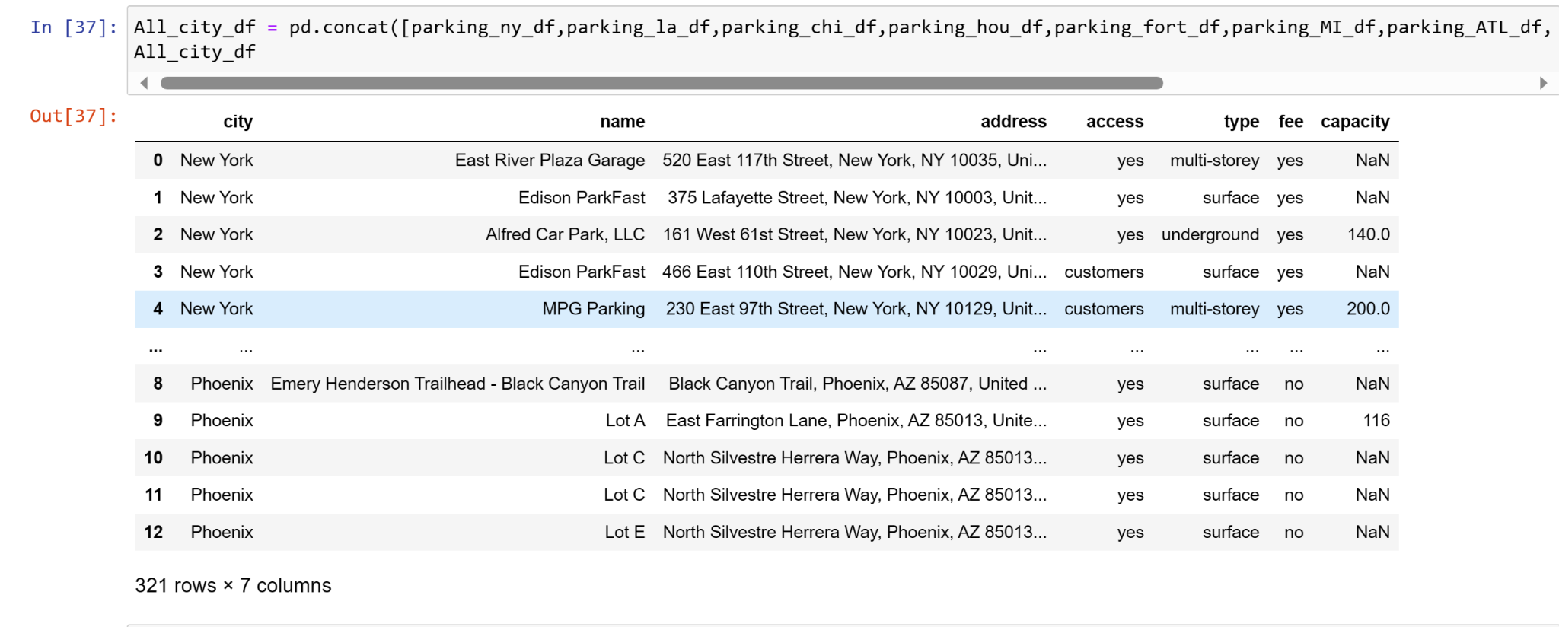

Slide 6
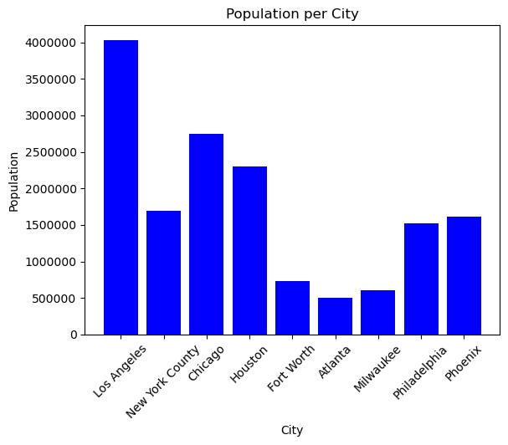
Population of the Cities Used
Kailey
What are the populations of the cities that we used?

Slide 7
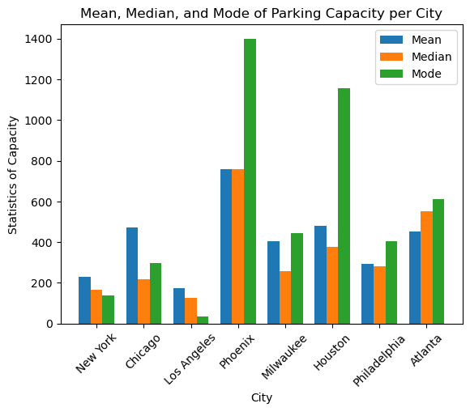
Parking Capacity, mean, median, mode
Kailey
What is the mean, median, mode of the parking capacity in the top 10 largest cities?

Slide 8
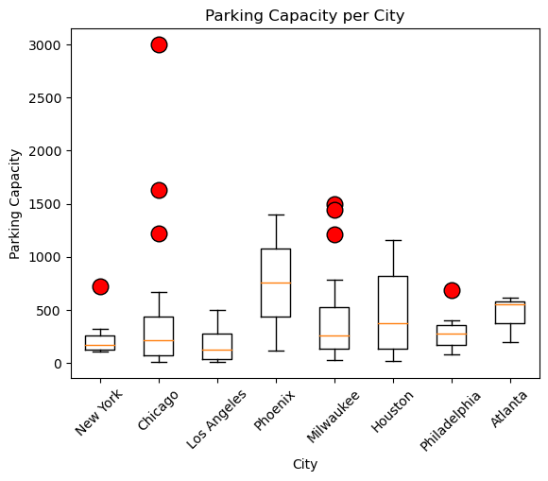
Parking Capacity, finding outliers
Kailey
What are the outliers within the data?
Notes:
I would say something along the lines

Slide 9
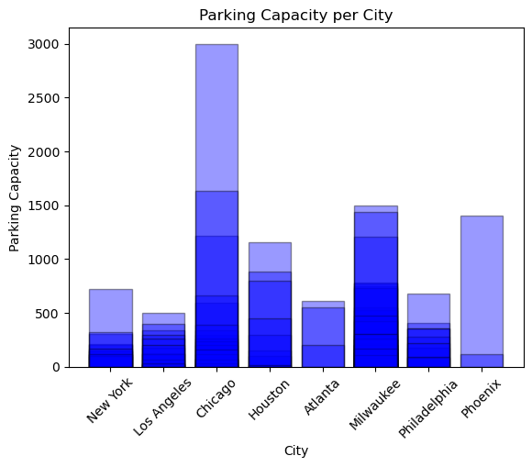
Parking Capacity Per City
Kailey
What is the parking capacity per city?

Slide 10
Comparing Population vs. Capacity
Kailey

Slide 11
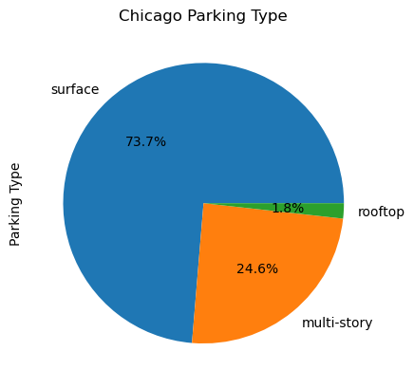
Parking Types in Chicago
How do the parking types vary in Chicago?

Slide 12
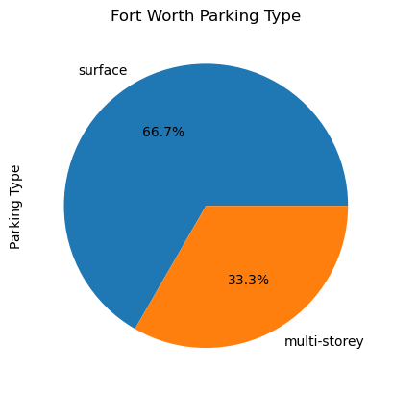
Parking Types in Fort Worth
How do the parking types vary in Fort Worth?

Slide 13
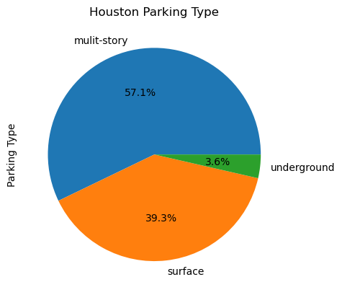
Parking Types in Houston
How do the parking types vary in Houston?

Slide 14
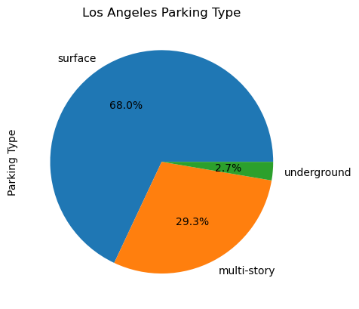
Parking Types in Los Angeles
How do the parking types vary in Los Angeles?

Slide 15
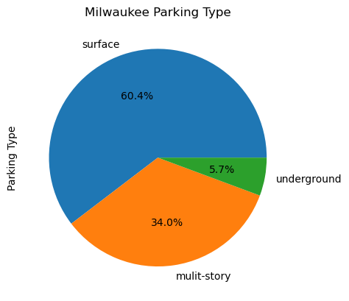
Parking Types in Milwaukee
How do the parking types vary in Milwaukee?

Slide 16
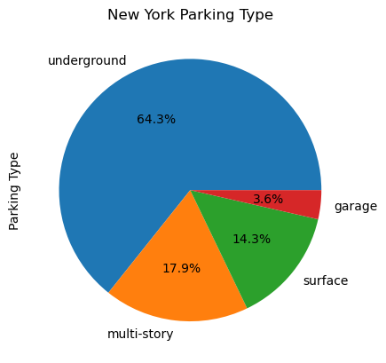
Parking Types in New York
How do the parking types vary in New York?

Slide 17
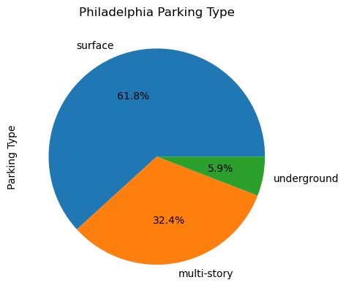
Parking Typed in Philadelphia
How do the parking types very in Philadelphia?

Slide 18
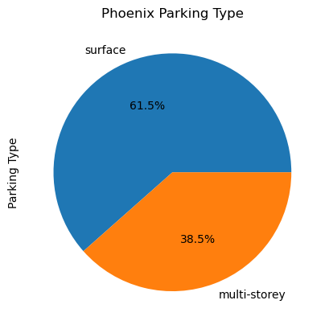
Parking Types In Phoenix
How do the parking types very in Phoenix?

Slide 19
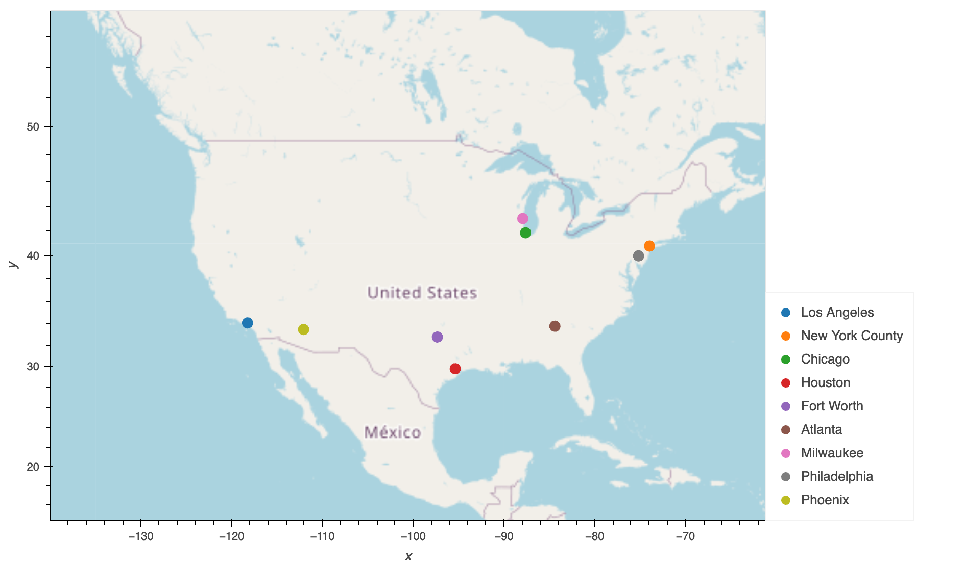
Parking Type Map
Which parking type is most popular within each designated city?
Notes:
Not sure if you may want to have the code pulled up to show how the map functions. It’s hard to see with just the image.

Slide 20
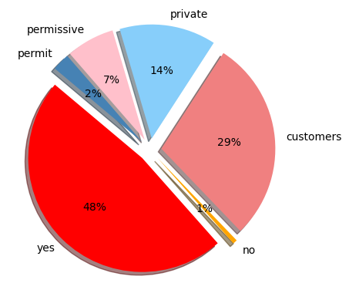
Parking Access
Jessica
What parking access type is the most common?
*** yes = public, no=governmental

Slide 21
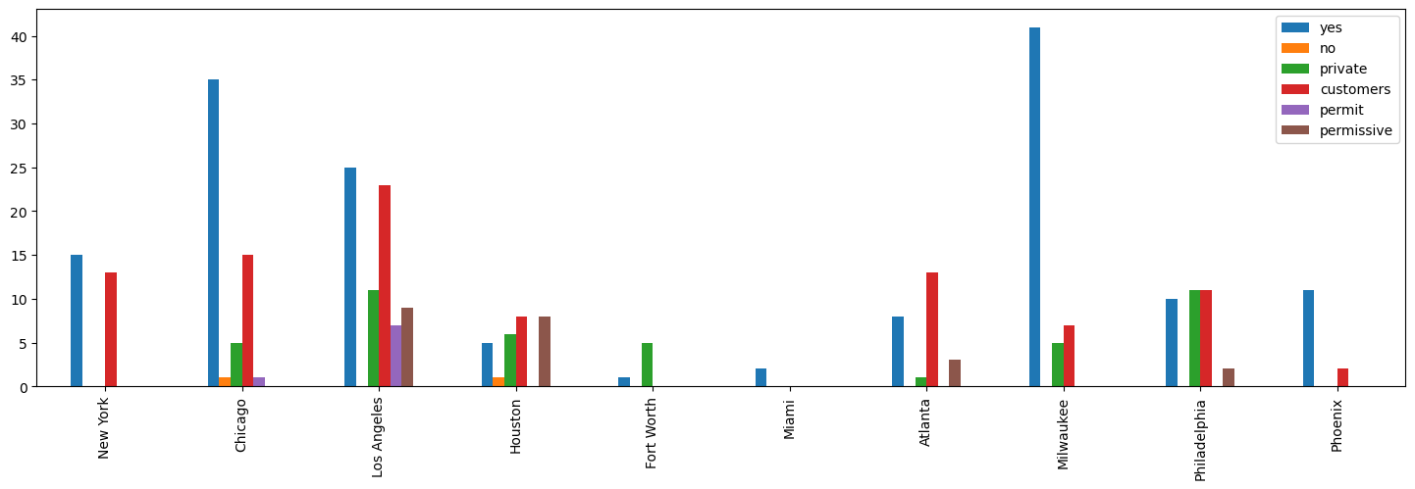
Parking Access Across All 10 Cities
Jessica
How do the parking types vary across all 10 of the cities?

Slide 22
Final Thoughts
Liz
Notes:
Summarize findings and hypothesis.
Findings : We pulled data from Atlanta (the smallest population) and Los Angeles (the biggest population)
and performed an Independent T-test. The pvalue came out to 0.15133837895751248. This accepts the null and
finds that there is no correlation between the population of a city and the capacity of their parking lots.

